Slide 1
Date : 2012/10/25
Author : Yosi Mass, Yehoshua Sagiv
Source : WSDM’12
Speaker : Er-Gang Liu
Advisor : Dr. Jia-ling Koh

Slide 2
Outline
Introduction
Language Model
Ranking Answers
IR Relevance (Language Model)
Language Models for Data Graphs
Normalization
Structural weights
Graph Weights
Experiment
Conclusion

Slide 3
Outline
Introduction
Language Model
Ranking Answers
IR Relevance (Language Model)
Language Models for Data Graphs
Normalization
Structural weights
Graph Weights
Experiment
Conclusion

Slide 4
Introduction
Finding the language
spoken in Poland
Type:country
Returns documents about Poland that might contain the needed information.
Poland
Type:language
Polish
Returning Polish as the spoken language of Poland.
Extract meaningful parts of data w.r.t. the keywords

Slide 5
Introduction - Data Graph
Structural node : tuple , Keyword node : keywords
Edges : foreign-key references
Edges and nodes may have weights
Weak relationships are penalized by large weights
Keywords

Slide 6
Introduction - Goal
Efficiently generating answer (Candidate answer)
Using the algorithm to create a node for each keyword of the given
query, and then add edges from keyword to all the nodes of the
data graph that contain keyword.
K. Golenberg, B. Kimelfeld, and Y. Sagiv. Keyword proximity search in complex data graphs. In SIGMOD, 2008.
Ranking the candidate answers (This Paper focus on)
Finding methods for effectively ranking the generated answers
according to their relevance to the user.

Slide 7
Introduction - Data Graph (Query)
Query = { Summers , Cohen , coffee }
Contains all keywords of the query

Slide 8
Introduction - Data Graph (Query Result)
Query = { Summers , Cohen , coffee }
An answer is a directed subtree of the data graph
Has no redundant edges (and nodes)

Slide 9
Introduction - Data Graph (Query Result)
Query = { Summers , Cohen , coffee }
An answer is a directed subtree of the data graph
Has no redundant edges (and nodes)

Slide 10
Outline
Introduction
Language Model
Ranking Answers
IR Relevance (Language Model)
Language Models for Data Graphs
Normalization
Structural weights
Graph Weights
Experiment
Conclusion

Slide 11
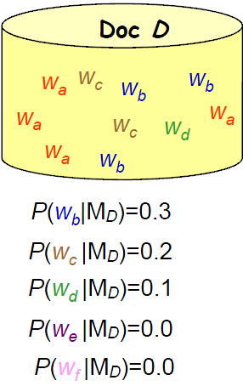
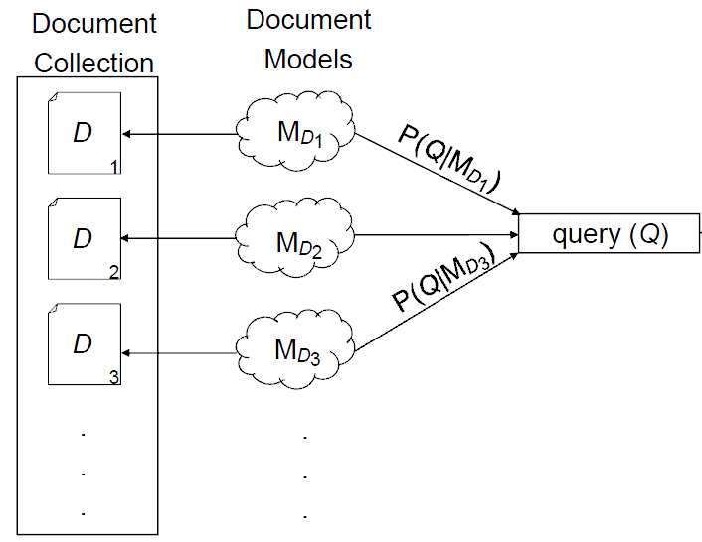
Language Model
Relevance(?
Unigram
• Each word occurs independently of the other words
• The so-called “bag-of-words” model (e.g., how to distinguish “street market” from “market street)

Slide 12
Language Model
Collection
Q = Wc,Wd,We
WaWaWaWa
WbWbWb
WcWc
Wd
P(Wa|MD1)=0.4
P(Wb|MD1)=0.3
P(Wc|MD1)=0.2
P(Wd|MD1)=0.1
P(We|MD1)=0
P(Wf|MD1)=0
Doc D1
P(Q | MD1)
= P(Wc | MD1)*P(Wd | MD1)*P(We |MD1)
= 0.2 * 0.1 * 0
The zero-probability problem :
If We do not occur in D1 then P(We |MD1) = 0
WaWa We
WbWb WfWf
WcWc
Wd
Doc D2
P(Wa|MD1)=0.2
P(Wb|MD1)=0.2
P(Wc|MD1)=0.2
P(Wd|MD1)=0.1
P(We|MD1)=0.1
P(Wf|MD1)=0.2
Smooth the document-specific unigram model with a collection model (two states, or a mixture of two multinomials)
WbWb
WcWcWc
Wd
WeWeWeWe
P(Q | MD1)
= P(Wc | MD1)*P(Wd | MD1)*P(We |MD1)
= (0.9* 0.2 + 0.1 * 6/30) * (0.9* 0.1 + 0.1 * 3/30)
* (0.9* 0 + 0.1 * 5/30)
Doc D3
P(Wa|MD1)=0
P(Wb|MD1)=0.2
P(Wc|MD1)=0.2
P(Wd|MD1)=0.1
P(We|MD1)=0.5
P(Wf|MD1)=0

Slide 13
Outline
Introduction
Language Model
Ranking Answers
IR Relevance (Language Model)
Language Models for Data Graphs
Normalization
Structural weights
Graph Weights
Experiment
Conclusion

Slide 14
Ranking Answer
Structural weights
Language models
Assigning structural weights to the nodes and edges of the data graph. These weights are derived only from semantic considerations and are static, namely, they are independent of any particular query
Language models are used to assign weights to the edges that connect the keywords of a given query to the nodes that contain them. These weights are dynamic, depending on the given query.
(The name l-score emphasizes that lower scores are better)

Slide 15
IR Relevance
(normalize)
(- ∞ ; Rmax] → interval [0; 1] )
MAX：ln( - Rmax + Rmax + 2.718 ) = ln (2.718) = 1 , = 1- 1 = 0
min：ln( - (-∞) + Rmax + 2.718 ) = ln (∞ ) = ∞ , = 1 - 1/ ∞ = 1
Using logarithm in the above equation so that lscr ir(Q;Af ) will not grow too fast as R(Q;Af )
Avoid underflow when taking the product of many probabilities.

Slide 16
Outline
Introduction
Language Model
Ranking Answers
IR Relevance (Language Model)
Language Models for Data Graphs
Normalization
Structural weights
Graph Weights
Experiment
Conclusion

Slide 17
Graph Weights - Weight of an Node
Static weights of nodes
Static weights of edges
The weight of a node v, denoted by w(v), is
static and depends on its incoming edges
, interval [0; 1]
Idg(v) = 1 :
v
ln( 1.718 + 1 ) = ln (2.718) = 1 , w(v) = 1 (max)
Idg(v) = 3 :
v
ln( 1.718 + 3 ) = ln (4.718) = 1.55 , w(v) = 0.645
The more incoming edges there are, the lower the weight is, which means that nodes with many incoming edges are more important.

Slide 18
Graph Weights - Weight of an Edge
Static weights of edges
Let fdg(e) be the number of edges that have the same type as e and are from u to nodes with the same type as v.
Let tdg(e) be the number of edges that have the same type as e, emanate from nodes with the same type as u and point to v.
An edge with fewer similar edges is more unique and, hence, describes a stronger semantic relationship between its nodes.
Strongest!

Slide 19
Outline
Introduction
Language Model
Ranking Answers
IR Relevance (Language Model)
Language Models for Data Graphs
Normalization
Structural weights
Graph Weights
Experiment
Conclusion

Slide 20
Experiment
Datasets:
Subsets of Wikipedia, IMDB and Mondial Web databases
Queries:
50 queries for each dataset including
Metrics:
Mean Average Precision (MAP)
The number of top-1 relevant results
Reciprocal rank

Slide 21
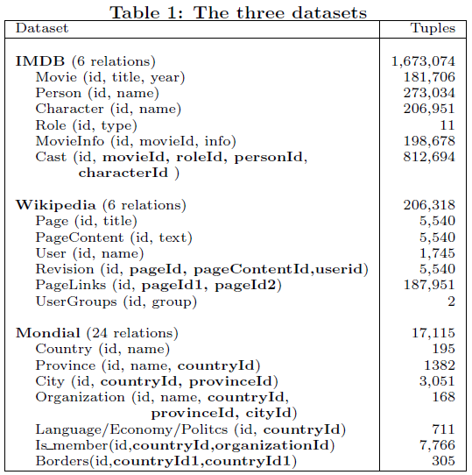

Slide 22
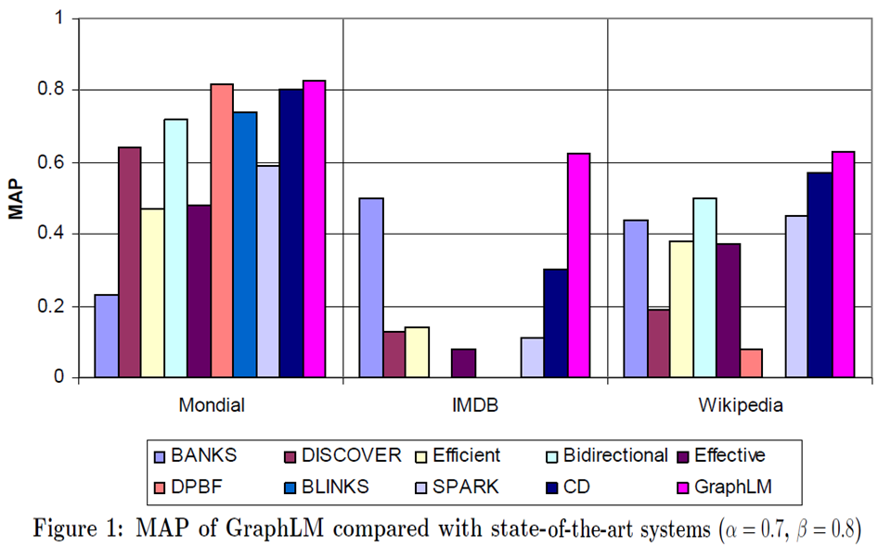
Experiment - MAP
0.82
0.828
0.623
0.626
0.5
0.57

Slide 23
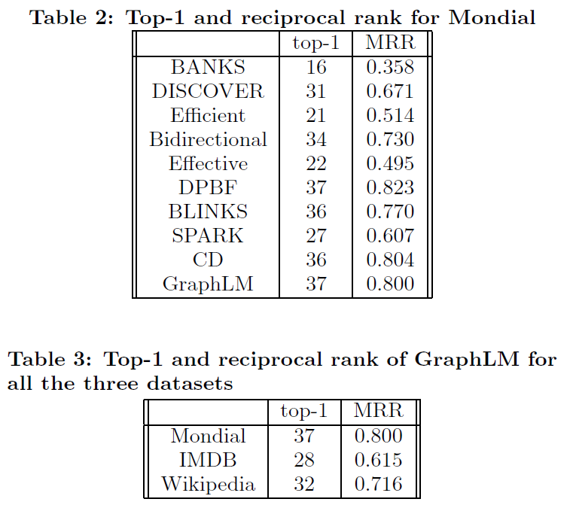
Experiment – Top 1 & RR

Slide 24
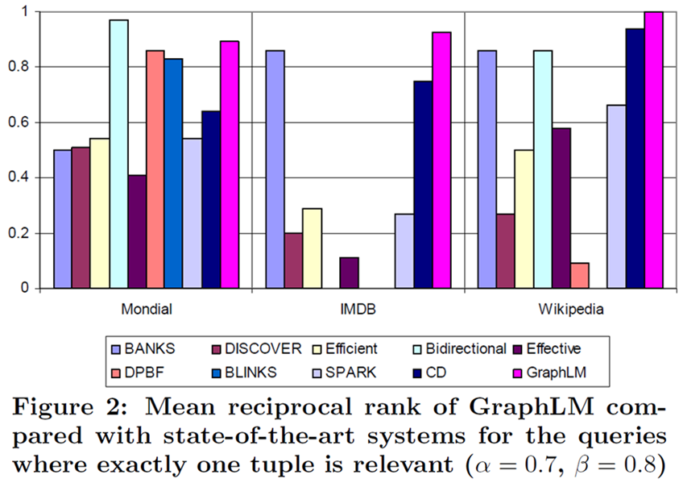
Experiment - MRR
0.97
1
0.925
0.924
0.891
0.86

Slide 25
Outline
Introduction
Language Model
Ranking Answers
IR Relevance (Language Model)
Language Models for Data Graphs
Normalization
Structural weights
Graph Weights
Experiment
Conclusion

Slide 26
Conclusion
Presenting a novel and effective ranking technique for keyword search over data graphs.
language models
structural weights
Conclude that systems for keyword search can also be used as effective retrieval engines

Slide 27
MAP(Mean Average Precision)
Topic 1 : There are 4 relative document ‧ rank : 1, 2, 4, 7
Topic 2 : There are 5 relative document ‧ rank : 1, 3 ,5 ,7 ,10
Topic 1 Average Precision : (1/1+2/2+3/4+4/7)/4=0.83。
Topic 2 Average Precision : (1/1+2/3+3/5+4/7+5/10)/5=0.45。
MAP= (0.83+0.45)/2=0.64。
Reciprocal Rank
Topic 1 Reciprocal Rank : (1+1/2+1/4+1/7)/4=0.473。
Topic 2 Reciprocal Rank : (1+1/3+1/5+1/7+1/10)/5=0.354。
MRR= (0.473+0.354)/2=0.4135。

Slide 28
Mean Reciprocal Rank (MRR)
Query
Query 1
Query 2
Query 3
Query 4
Query 5
Ranking
Result
1.
2.
3.
4.
5.
1.
2.
3.
4.
5.
1.
2.
3.
4.
5.
1.
2.
3.
4.
5.
1.
2.
3.
4.
5.
1/2 1 1 1/4 1/3
Reciprocal
Rank
MRR = ( $\frac{1}{2}$+ 1 + 1 + $\frac{1}{4}$ + $\frac{1}{3} )$
/ 5 = 0.617
Notes:
此評估法分數越高表示，系統越能在前幾個答案中便回答問題
n為問題個數，rank(qi)表示系統第一個正確回答問題qi的答案排行(answer rank)。
假如系統在第2 個排行正確回答了問題，則這問題的分數為1/2，最後計算問題的平均分數即可。
如果系統最後的MRR 值為0.5，表示此系統平均在第二的答案中即可回答正確答案

